Slide 1
Robert bejenaru
Retail Sales Performance Analysis (Power BI Desktop)
I’ve joined the Sales Analytics team at a retail company.
Senior management wants a Power BI report and a short presentation to help them: monitor sales performance, identify trends, compare regions and product categories, and understand the impact of discounts and costs.

Slide 2
The dataset contains transaction-level retail sales records, including:
Order information: OrderID, OrderDate, ShipMode
Customer segmentation: CustomerSegment
Geography: Country, State, City, Region
Product: Category, SubCategory
Numeric fields: Quantity, UnitPrice, Discount, Unit_Cost

Slide 3
Column Name | Data Type | Format | Data Category
OrderID | Text | Text | Uncategorised
OrderDate | Date | Short Date | Uncategorised
ShipMode | Text | Text | Uncategorised
CustomerSegment | Text | Text | Uncategorised
Country | Text | Text | Country/Region
State | Text | Text | State or Province
City | Text | Text | City
Region | Text | Text | Country/Region
Category | Text | Text | Uncategorised
SubCategory | Text | Text | Uncategorised
Quantity | Whole Number | Whole Number | Uncategorised
UnitPrice | Decimal Number | Currency (2 D.P) | Uncategorised
Discount | Decimal Number | Percentage (1 D.P) | Uncategorised
Unit_Cost | Decimal Number | Currency (2 D.P) | Uncategorised

Slide 4

Data Understanding & Preparation (Power Query)
The dataset has the first rows as column names
So I used the “Use First Row as Headers” option to turn the first row into column names
This is so that I can use the column names to sort/filter the data and to be able to correctly reference the relevant data for visualisations and calculations

Slide 5


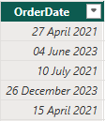



Check / Set Data Types
I changed the OrderDate Data type from “text” to “Date”
The format was as a long date format and I changed it into a short date format
This is better for dashboards as it uses less space in tables, slicers and charts
I changed the UnitPrice Data type from “text” to “Decimal number”
I changed the Format from General to Currency with 2 D.P
This is so unit prices are reflected as dollars which is appropriate to the dataset consisting of orders made in the united states

Slide 6








Check / Set Data Types
I changed the Quantity Data type from “text” to “Whole number”
I changed the Discount Data type from “text” to “Decimal number”
I have changed the format from General to Percentage with 1 D.P
This makes the applied discount easier to understand and more visually appealing for the viewers of the dashboard
I changed the Unit_Cost Data type from “text” to “Decimal number”
I changed the Format from General to Currency with 2 D.P
This is so that the unit costs are displayed appropriately as a currency and rounded to the same degree that is used in real life

Slide 7







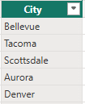
Set Data Categories
I have categorised the following location data columns into the relevant data categories:
Country - Country/Region
Region - Country/Region
State - State or Province
City - City
This is so that if needed I can use the locations to create a map visual of orders across different regions/cities/states

Slide 8
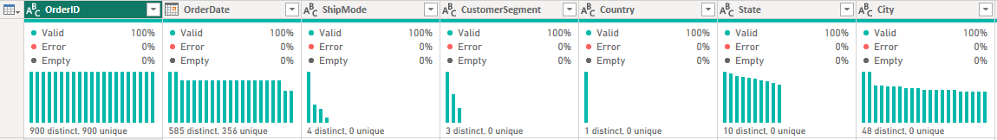

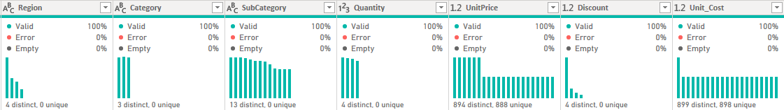
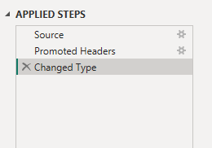
Data Understanding & Preparation (Power Query)
From viewing the dataset using the column quality, column profile and column distribution:
There are no empty/null/blank values
There are no data errors such as misspelling
There are no duplicates of rows as seen by the OrderID column having 900 distinct and unique values

Slide 9
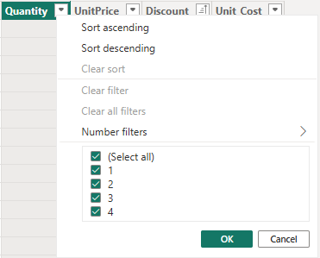
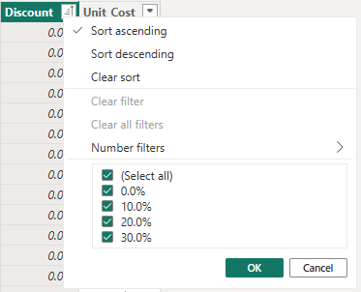
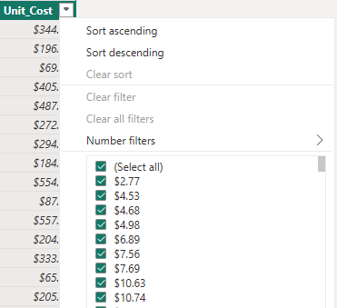
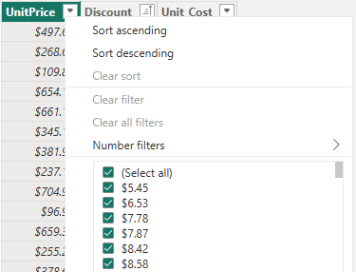
Data Validation
For the Quantity column, there are no orders below 1 or outliers
For the Discount column, there are no discounts over 100% or less than 0%
For the Unit_Cost column, there are no negative or zero values
For the UnitPrice column there are no negative or zero values
For all of the columns in the dataset, there are no data validation issues so the data is ready to be used for visualisation and analysis

Slide 10

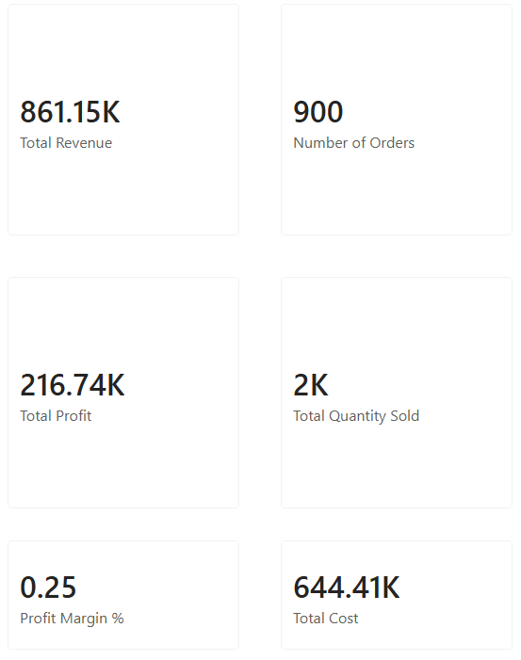
Core Calculations (DAX Measures)

Slide 11
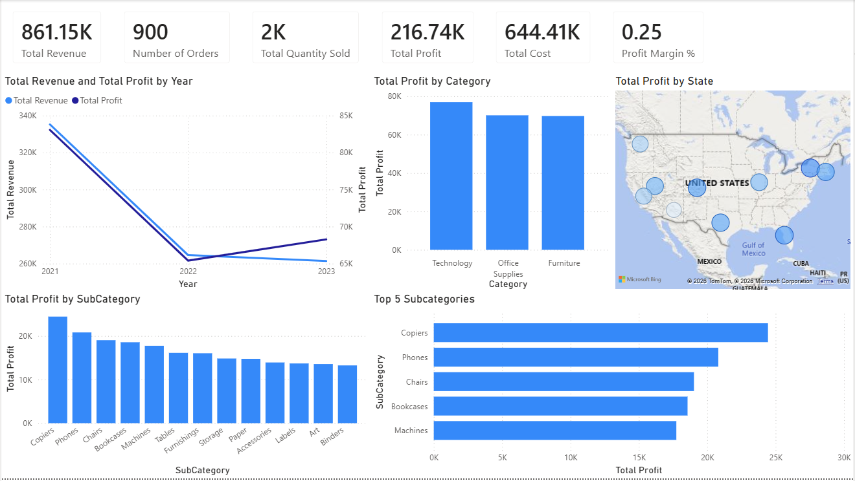
Senior Management Report Page
Profit and revenue declined significantly from 2021 to 2022, with revenue continuing to decline from $264,594.06 to $261,342.66 from 2022 to 2023
On a positive note, despite the decline in revenue, from 2022 to 2023, the total profit increased from $65,398.45 to $68,273.75
We can see that Technology is the leading category in terms of total profit with $76,911.04
Technology subcategories (Copiers, Phones and Machines) are in the top 5 subcategories for total profit, explaining the reason for technology being the leading category
Despite the west region having the most states, they don’t generate as much profit individually compared to states in other regions

Slide 12
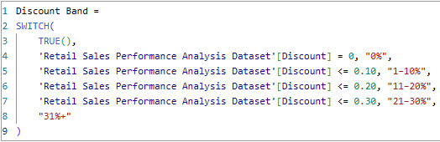
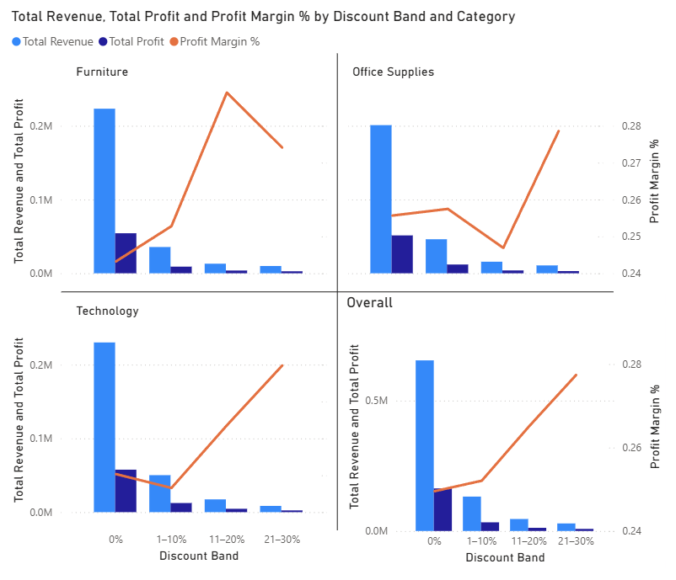
Discount Impact on Profitability
Overall, we can see that the 21-30% discount band has the highest profit margin. However, by looking into each category, we can see that furniture sales suffers from a decrease in profit margin when going from the 11-20% discount band to the 21-30% band
We can see that for Office Supplies, the profit margin decreases at the 11-20% discount band but has a significant increase at the 21-30% band
For the Technology category, we can see that the 1-10% discount band slightly reduces the profit margin and it would be better to have no discount instead
The 1-10% discount band appears to be the riskiest overall as it doesn’t provide much more of an increase in profit margin from a 0% discount compared to the other discount bands.
It would be worthwhile to investigate the drops in profit margin for certain discount bands in each of the categories. For example: the 1-10% discount band for the technology category and the 11-20% discount band for the Office Supplies Category
Perhaps it would be better to have discounts for certain subcategories and no discount for others in order to increase the overall profit margin.

Slide 13
Limitations and Next Steps
A key limitation is that the analysis is based only on historical sales data. We don’t have data on external factors such as overall market performance or competitor activity
For example, the drop in total profit and revenue from 2021-2022 could be due to external factors including economic conditions and the overall market might have been affected
Furthermore, it could be that the retail company outperformed its competitors during this period but we wouldn’t be able to tell without further data
Another limitation would be that the data focuses primarily on sales, costs and discounts
This limits visibility into other business drivers such as customer satisfaction, repeat customers and any refunds
The retail company should look into the reasons behind the drastic decline in revenue after 2021 to identify any risks and recovery opportunities
They should also expand analysis into customer retention and behaviours to identify any high-paying customers and explore customer loyalty strategies
Additionally, they should review their discounting strategies in order to optimise their profits and efficiently price their products, seeking to protect and increase profit margins.

